Slide 1
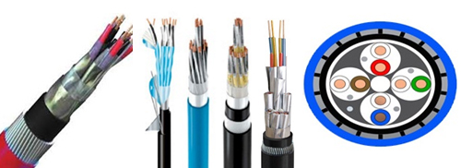
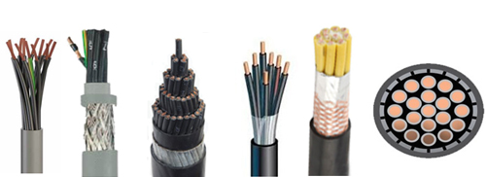
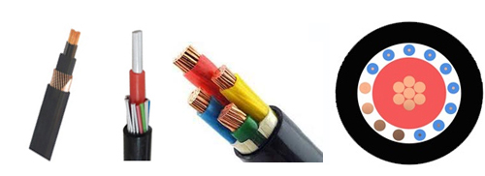
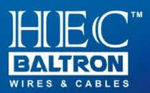
Hitesh Electric Corporation
Leadership in Distribution

Slide 2
We Are Glad To Learn That Your Organization Has Been Handling Various Projects & Contributing To The Rapid Growth In Respective Sectors.
We Would Like To Associate Ourselves With All The Projects By Catering To You Electrical Wires, Cable Trays, Cable Jointing Kits & Ht Panels As Per Requirement On Long Term Basis.
Hitesh Electric Corporation Is One Of The Largest Distributors For Leading Brands Like:
POLYCAB, HAVELLS, KEI, FINOLEX, CENTURION, BALTRON Instrumentation Cables, RAYCHEM & 3M Cable Jointing Kits

Slide 20
Other then Above wide range of cables covering
TBM / Mining Cables
CRD - EPR Rubber
Composite Cables
EHV cables up to 220Kv
PVC Insulated Single core & Multicore flexible Industrial cables
Telephone Switch Board
Jelly field cables
CC Tv Cables
Co-axial Cables
RS485 Cables
Cable Trays : G.I Perforated
FRP Cable Trays

Slide 21
Hitesh Electric Corporation
147, Lohar Chawl, 9‐Tavawala Building, Mumbai 400067
Office :  022-22096361/ 22064216/ 28628834
Dharmesh Sodha – 9820148398
Email: dvcable@gmail.com
We Believe in : Work Start to Finish
Happy To serve you Best !!!

